Slide 1
Film Data Study
Using data to predict popular film composition
Byungchan Kim
Springboard Capstone Project

Slide 2
Overview
Problem
Data Scoping
Data Wrangling
Exploratory Data Analysis
Predictive Modeling
Retrospective

Slide 3
Problem
Movie is an investment.
Wouldn’t it be great if we know which types of movies will be successful?
Notes:
Film is a multi billion dollar industry. Making a single movie in Hollywood costs around 70 to 150 million dollars. Production companies acquire the budget from investors and partner with various outsourcing companies such as CGI, motion capture and even agencies to create what the directors and writers had envisioned. A lot of the times, the production companies are able to earn what they have spent on making the movie. Many other times, the earnings are less than the cost. Very few occasions with just the right composition, a movie can bring in billions of dollars worldwide. So what is the “right composition”?

Slide 4
Data Scoping
Data sourced from IMDb
https://datasets.imdbws.com/
Only movie related data files were selected
For this learning project, only considering below data
Basic Movie Info : title, length, year released
Movie Ratings and Votes
Primary Directors
Notes:
All data used in this project has been supplied by IMDb.
Data contains film related data from 1890’s and is updated everyday.
The full data is consisted of 7 different tsv files. The description for each data file can be found on https://www.imdb.com/interfaces/ . Because this project is specific to movies, we will not be using some of the data files like tv episode info or region specific info.
As this is a learning project, the scope of this project is very tight. Out of the movie composition data, we will only look at titles, year, length, genres, directors only.

Slide 5
Data Wrangling
Relevant tsv files imported
Checked for nulls and duplicates
Required features scattered across multiple data files
Basics : title, length, year released, rated ‘r’
Names: directors
Ratings: average rating, number of votes
Merged to a master dataframe
Another null check to drop any movies missing above fields

Slide 6
Data Wrangling
Column ‘genres’ feature engineering
Contains up to 3 genres out of 28 making total of 1230 combinations
Encoded by adding 28 columns for each genre
Top 5 genres were later chosen totalling 23 genre combinations
Creating ‘popularity’ metrics
Ratings data unreliable as number of voters also plays a role
Popularity feature created by using the two features.
popularity metric = averageRating * numVotes/totalVotes
Notes:
Genres column contained up to three different genres out of 28 different genre types. Due to this, there were 1230 different genre combinations that made it difficult to categorize. Two approaches were used to account for this.
For ease of genre component analysis, 28 columns comprising of each genres were added to the dataframe with 1 or 0 representing the inclusion of the genre for movies.
For ease of movie categorization, top 5 genres were found and stripped other irrelevant genres from the list of genres so there were 23 genre combinations to work with instead of 1230.

Slide 7
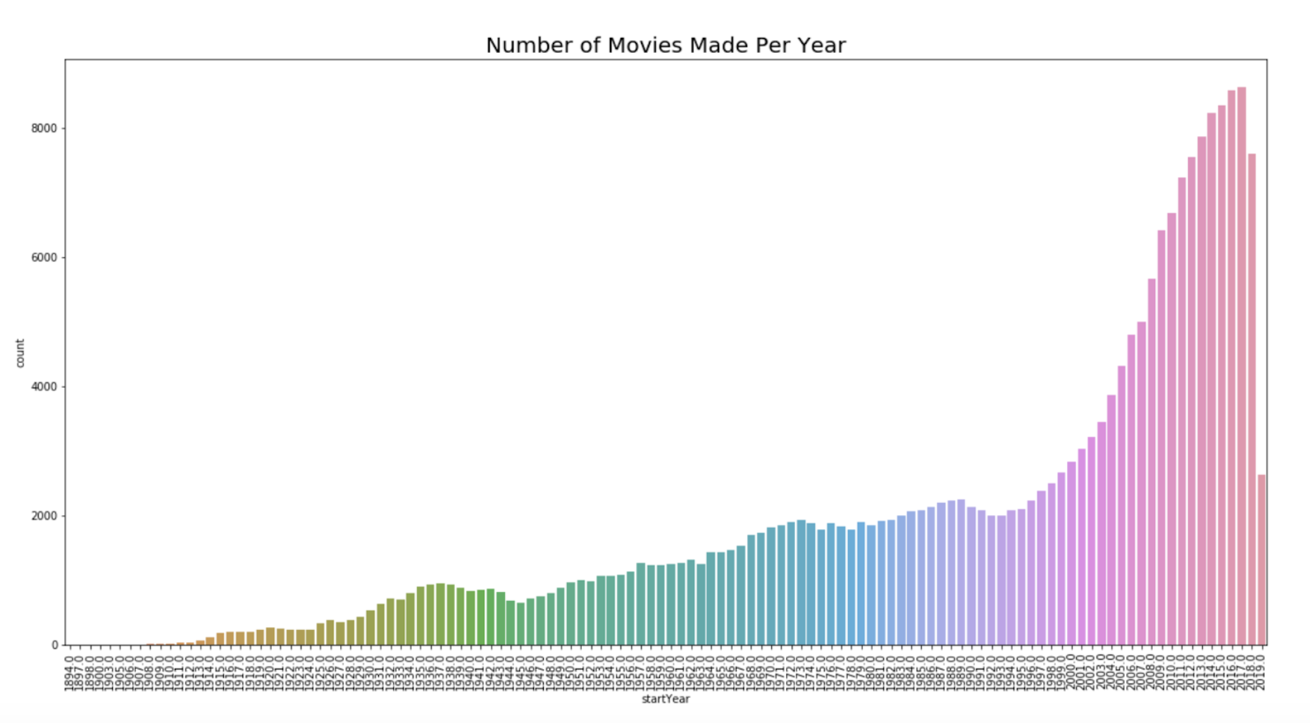
Exploratory Data Analysis
Notes:
Steady increase in number of movies were seen from 1890’s until 1990’s.
From 2000’s, number of movies released was increased significantly.
2018 and 2019 showed a decrease due to data being collected in Q2 of 2019 where not all movie data were fully entered.

Slide 8
Exploratory Data Analysis
Runtime
Range: 1.0 ~ 51420.0
1.5 IQR to determine outliers. Bounds: 57.5 to 125.5
Average runtime of movies was increased by 12% since 1890’s to present.
Directors
Total number of directors : 94577
One-time directors removed to isolate veteran directors
After removing: 30857
Notes:
Number of directors in the master dataframe: 94577
One of the points of this project is to find characteristics in movies that would make it popular. Although there can be exceptions, directors who have only directed or produced one movie are not likely to be considered as popular movie directors.
After removing one-time directors: 30857

Slide 9
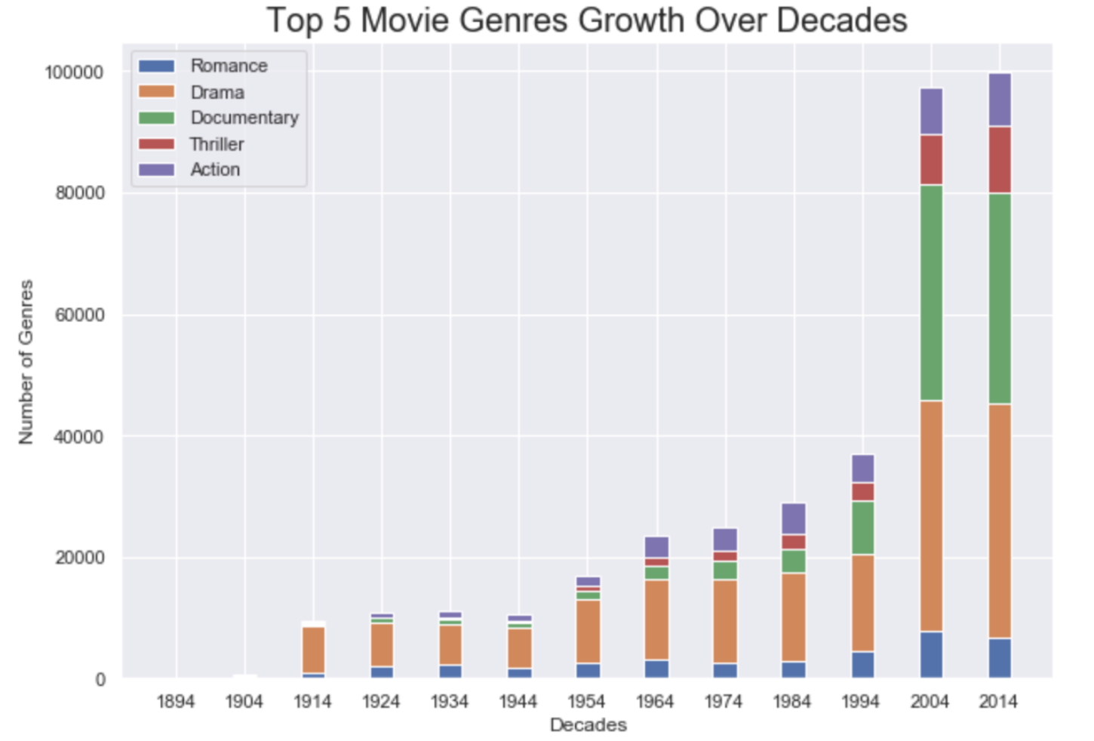
Exploratory Data Analysis
Most widely used:
Drama
Highest growth:
Documentary
Highest growth in past decade:
Action
Thriller
Notes:
There has been an increase on overall movie production from the 90's to 2000's. We can see from this chart that Drama has been and still is leading genre of all times and there has been a rapid growth in Documentary type of movies after year 2000. We can also see that the remaining genre types are also growing steadily as there are more movies being produced year after year.

Slide 10
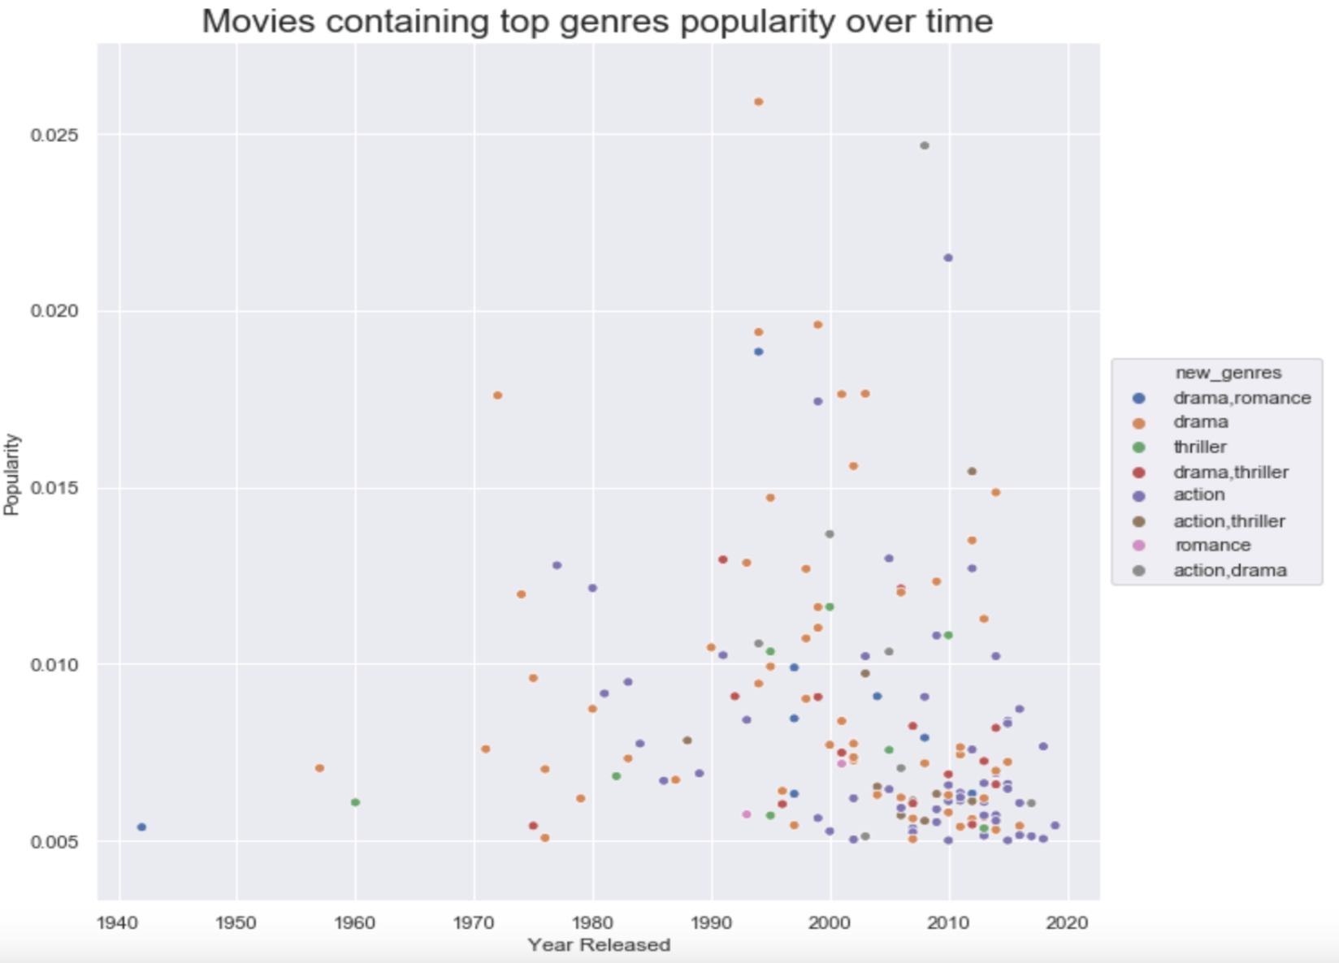
Exploratory Data Analysis
Notes:
Drama is the leading genre component that is embedded in almost all of the popular films. Quite a lot of orange data points that is just 'Drama' but this is due to our feature engineering. So these orange Drama data points can be a mixture of Drama genre and any other lesser used genre components like Fantasy or Sci-Fi.
Next, we can see the increase in the amount of popular action films. The Drama genre distribution is very consistent throughout so we can assume that Drama genre is a somewhat 'backbone' of good film production.
However, we have not been seeing a lot of popular action films until late 1970's. And since then until 2019, we can see it has become the 2nd most included genre in our 'popular' films. This is represented by the purple, gray and brown data points that we can see a lot more from 2000-2020. By the late 2010's, we are even seeing more action type films over drama type films.

Slide 11
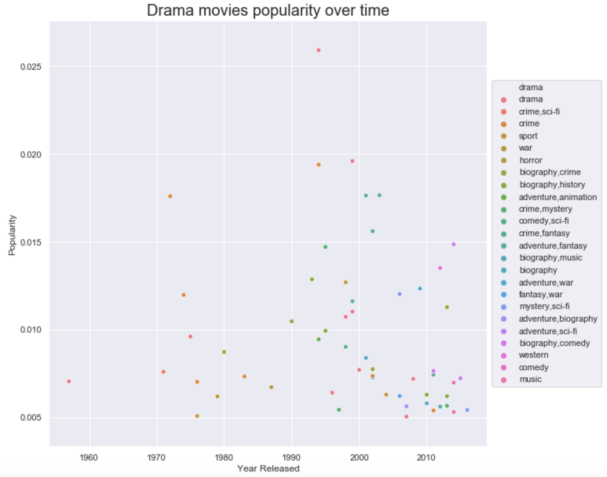
Exploratory Data Analysis
Movies prior to 2000’s:
War
Crime
History
Biography
Movies after 2000’s:
Sci-fi
Fantasy
Adventure
Comedy
Notes:
It is noticeable that there were more movies with ideas of War, Crime, Biography and History related popular movies until the 1980's. Then the trend changes to more of Crime, Fantasy, Adventures and Mystery until the latter half of 2000's. From then on until now, we are seeing a lot more of Sci-fi, Fantasy, Adventure and Comedy.
In the early years of film production, the CGI technology was not readily available and very expensive. The first movie to adopt CGI was in 1973's Westworld. In this era, practical effects were mainly used and because of the limited CGI capabilities, popular movies were mostly based on very real or historical events or storylines that did not involve a lot of computer generated images.

Slide 12
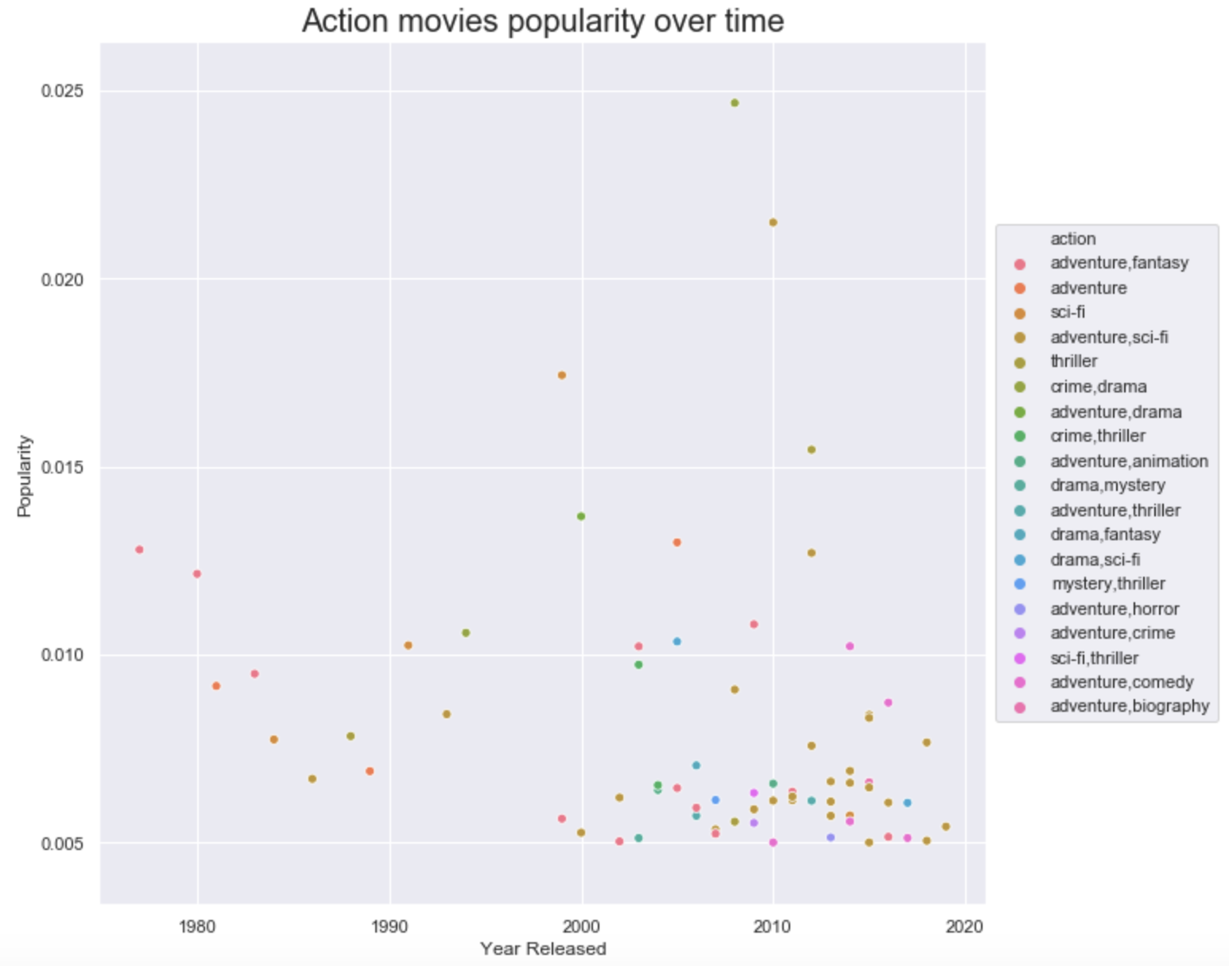
Exploratory Data Analysis
Recent Action sub-genres:
Adventure
Sci-fi
Comedy
Thriller
Notes:
They are almost dominated by adventure and sci-fi in the modern film making era which is what we expected from the previous drama only movies investigation. It also looks like action movies are likely to be paired with Adventure genre which makes sense as for an action film as it is important for characters to express these "actions" in different places.

Slide 13
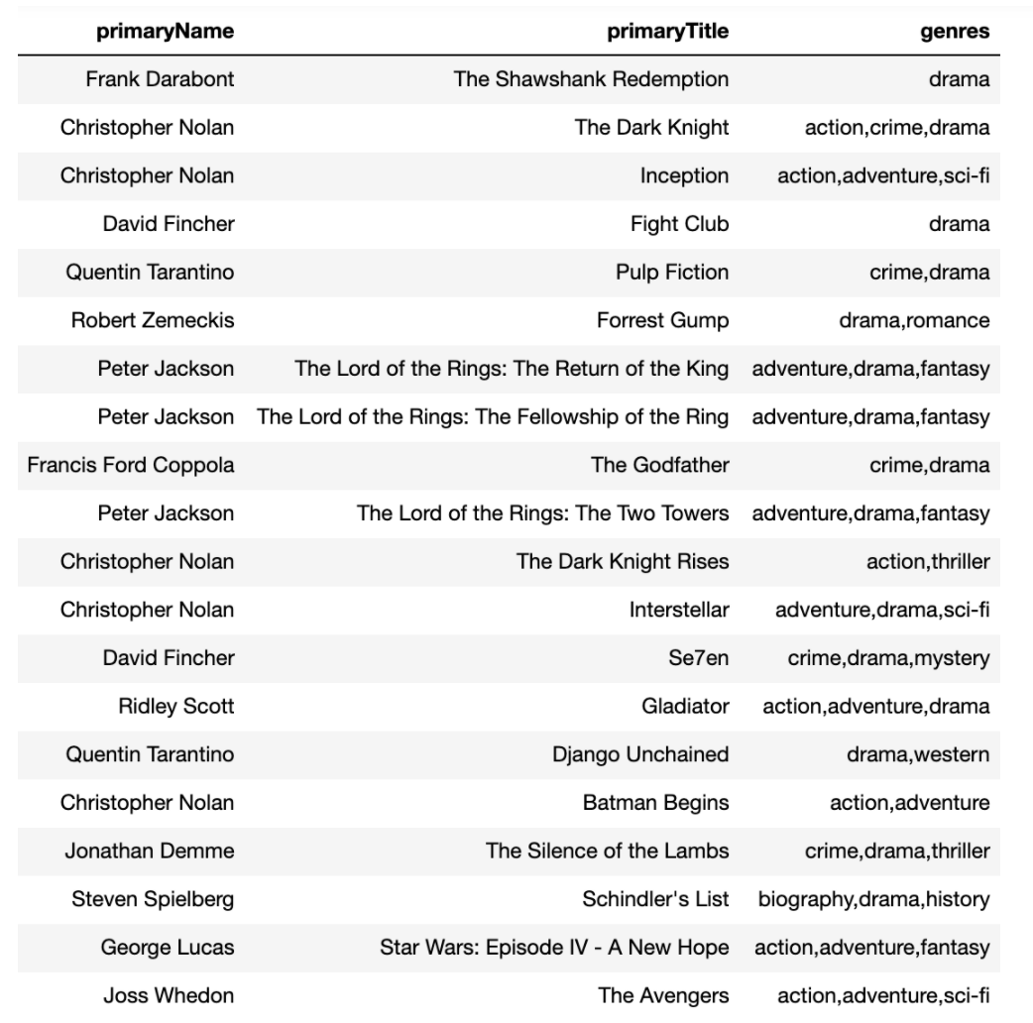
Exploratory Data Analysis
Top 20 Movies and Directors
Genres mostly
Action
Drama
Sci-fi
Fantasy
Notes:
The above shows the top 20 popular movies' director list. We can see Christopher Nolan having the most movies in the top 20 with 5 movies. Next, Peter Jackson takes the 2nd place in most movies in top 20 with his Lord of the Rings trilogy. Next, we have David Fincher and Quentin Tarantino for Fight Club, Se7en and Pulp Fiction, Django Unchained respectively.
From this list, we can see that Christopher Nolan's movies, which are all relatively new movies within a decade or slightly over, along with Peter Jackson, contains the combination of genres: Action, Drama, Sci-fi and Fantasy.

Slide 14
Predictive Modeling
Goal - Given movie details, predict if movie will be popular
Classification problem where prediction ranges from 0~2
0 : below-average rating movies
1 : average rating movies ( 5.0 ~ 7.5 out of 10.0 )
2 : popular movies ( 7.6 and above rated by at least 500,000 voters)
Processing
Selection : 17 categorical features and 1 numeric feature
Dataset : Large (600,000) and Down-Sampled (200,000)
SMOTENC sampled to account for imbalance
Notes:
We have a heavily skewed dataset. Our goal is to correctly identify the movies that might become popular but our dataset only consisted of around 70 movies categorized as 2 or 'popular'. If we are building a model that identifies the 0's well, we would have less issues but we are mainly focused on finding 2's. Having less that 0.1% of 2's in the data frame will not produce a model with high accuracy.
Therefore, we are using SMOTENC to equalize the three categories' distribution.

Slide 15
Predictive Modeling
Models tested :
Logistic Regression
Random Forest Classifier
Support Vector Classifier
Hyperparameter Optimization :
RandomizedSearch
GridSearch CV (cv = 5)
Notes:
We are interested in identifying as much 2’s as possible. Even if we miscategorize a non-2 as a 2, this is less of a concern for us than failing to identify 2’s as non-2’s.
Therefore all optimization efforts have been focused to recall

Slide 16
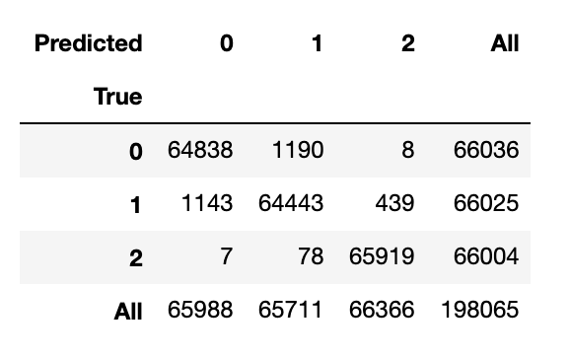
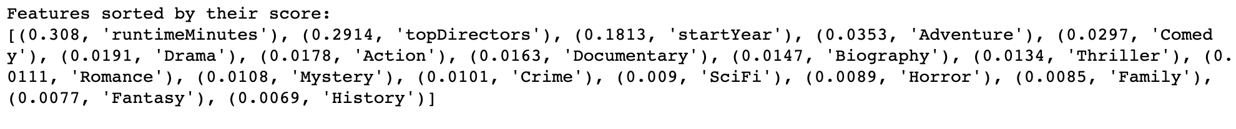
Predictive Modeling
Random Forest Classifier
Shows most promising results
Overall accuracy 0.98
Better with Large dataset
RandomizedSearch + GridSearchCV
Notes:
It looks like a primary determinant if predicting great movies by the top directors. More so than not, the runtime of the movies also claim a big proportion when it comes to important features. This is most likely the more eccentric movie runtime has a significantly lower popularity rating than the traditional movie configurations. Year releases also seem to have a big impact and then we move on to the genres. As expected a lot of the top 5 genres we've seen so far are included as the biggest decision makers out of genres (Adventure, Comedy, Drama, Action, Thriller).

Slide 17
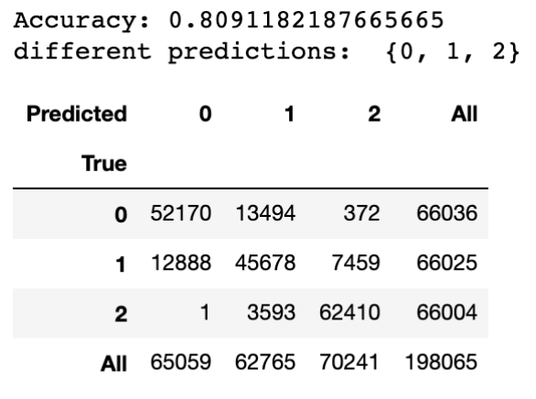
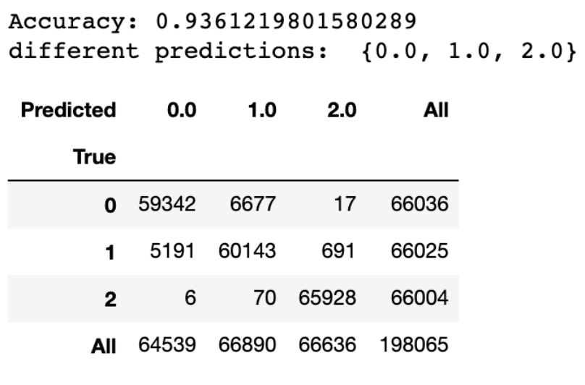
Other Models
Logistic Regression after optimization :
RandomizedSearch
Down-sampled dataset
SVC after Optimization :
GridSearchCV
Large dataset
Notes:
We are interested in identifying as much 2’s as possible. Even if we miscategorize a non-2 as a 2, this is less of a concern for us than failing to identify 2’s as non-2’s.
Therefore all optimization efforts have been focused to recall

Slide 18
Retrospective
Overfitting
99.3% is impossible in real life
Most important feature : Directors
Feature importance show too much weight to irrelevant features
Runtime minutes ~30%
Possibly due to filtering out any outlying movies
Year released ~18%
Possible due to career span of top directors
Notes:
Throughout various model testing, RandomForestClassifier proved to be the best model for this job. After hyperparameter optimization and cross validating, the model accurately predicted the popular movies to 99.3%.
In real life, this is a ridiculously accurate model which means, this model is either overfitting or our dataset has become too simple where just a few columns determine whether a movie will be popular or not.
We can see that we have a categorical variable ‘topDirectors’ having almost 30% weight in determining the popularity followed by similar weight from ‘runtimeMinutes’ and lastly, 18% for the ‘startYear’. These account for almost 80% of the importance ratio. And speaking outside of the modelling, we know that movie runtime and year released is something actual viewers do not think about or consider when deciding whether a movie is liked or not.
This means that the actual determinant of a popular movie is the director. It makes sense in a way and we can also explain how runtimeMinutes and startYear come to have this much importance if we start thinking this way. Whether a movie was directed by one of the top directors or not also depends on the startYear. As the data collects movies since the 1890's, most of our topDirectors are involved in these movies. Also since the beginning of film age, a lot of different runtimeMinutes have been tried in movies.
The model is likely using the runtimeMinutes column to filter out any movies that are too short or long running (as the popular movies used for training follows strict 1.5hr to 2.5hr runtime) and startYear to further filter the movies released during top directors’ career and finally, whether the movie was actually directed by one of the top directors.
Issues
This creates an issue if we use the model later down the road when the model is not aware of the new up and coming directors. Until those movie lists are updated, even if in the future, we input a movie released that was known to have been successful, our model would not be able to predict that it would be popular as it has a limited knowledge of top directors and the model is highly focused on the director list and its effects in runtime or start year.
To fix this issue, we may try to remove the start year and runtime minutes out of the modelling process in the hopes of giving the actual genres a bit more importance.

